Slide 1
AH GSM – Animal Health CMO Poultry Devices
Maintained By CMO Devices Team

Slide 2
Table of Contents
Device | Page
Hatchery Vaccination Devices | 3
Nobilis Injector Single V 2.0 | 4
Nobilis Injector Double V 2.0 | 5
Innoject Pro | 6
Jectmatic V2 | 7
MSD MONO VACCINE HATCHERY SPRAY CABINET | 8
MSD DOUBLE VACCINE HATCHERY SPRAY CABINET | 9
MSD MIDHAS | 10
MSD Spray Wagon Trolley | 11
MSD Double Breast Vaccinator (DBV) | 12
MSD Double Breast Vaccinator (DBV) Information Video | 13
MSD Double Breast Vaccinator (DBV) Accessories and Spare Parts | 14
MSD Double Breast Vaccinator (DBV) Accessories and Spare Parts Cont. | 15
MSD Double Breast Vaccinator (DBV) Accessories and Spare Parts Cont | 16
STABBER-WINGWEB | 17
NOBILIS BATTERY POWERED SPRAYER REB 15 | 18
BIRCHMEIER AS 1200 SPRAYER BLOWER WITH BATTERY | 19
VectorFog C150 PLUS | 20
Supplier Contact Information | 21

Slide 3
HATCHERY VACCINATION DEVICES
HATCHERY VACCINATION
Day Old Chick (DOC) Subcutaneous Vaccination | Day Old Chick (DOC). Spraying Vaccination
Nobilis Injector Single V 2.0 Nobilis Injector Double V 2.0 Innoject Pro Single Innoject Pro Double Jectmatic V2 Single Jectmatic V2 Double | Birchmeier REB 15 Backpack Sprayer MONO VACCINE HATCHERY SPRAY CABINET DOUBLE VACCINE HATCHERY SPRAY CABINET MIDHAS (replaces SprayCox)

Slide 4
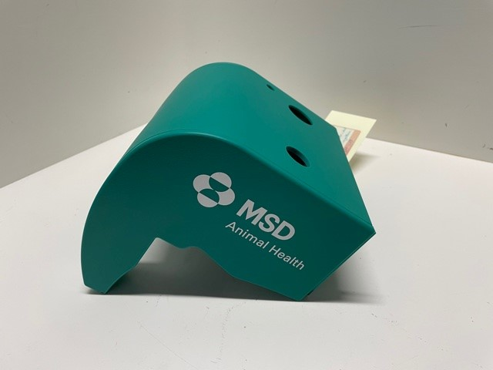
NOBILIS SINGLE SUBCUTANEOUS INJECTOR
BY ZOO TECHNIQUES
Vendor Number 3116041 / NET 60
Purpose:
Automatic Mass Vaccinator for Poultry. The ZOOTEC is a pneumatic machine that ensures automatic vaccination of 1-to-14 day-old poultry (chickens, ducks, turkeys, guinea fowls, etc.) subcutaneously in the neck and intra muscular in the leg. The retention plate provided is suitable for 1-to-7 day-old chicks. For 8-to-4-day-old chicks, an additional retention plate is available on a special order basis. The ZOOTEC accepts any type of vaccines (water-based and oil based), as well as vitamins and antibiotics. Injection volumes can vary from 0.1 ml to 0.5 ml by changing the syringe (by 0.1 –ml). The machine can be operated by only one operator who will acquire a work rate of 2 500 chicks per hour after a short training period. The correct cadence for a good vaccination is 2 500 chicks per hour. The machine requires external supply of compressed air with a pressure comprised between 5 bars and 12 bars. Pressure will then be regulated to 4 bars inside the machine.
Used With Vaccines Such As:
Coccidiosis or Respiratory Vaccines. Not specific for just one product range.
Can apply Nobilis M65.
Contains:
1 x Nobilis SINGLE SUBCUTANEOUS INJECTOR
1x Box of 100 Deposable needles
1 x Repair Kit
1 x Container of Vaseline

Slide 5
NOBILIS DOUBLE SUBCUTANEOUS INJECTOR
BY ZOO TECHNIQUES
Vendor Number 3116041 / NET 60
Purpose:
Automatic Mass Vaccinator for Poultry. The ZOOTEC is a pneumatic machine that ensures automatic vaccination of 1-to-14 day-old poultry (chickens, ducks, turkeys, guinea fowls, etc.) subcutaneously in the neck and intra muscular in the leg. The retention plate provided is suitable for 1-to-7-day-old chicks. For 8-to-4-day-old chicks, an additional retention plate is available on a special-order basis. The ZOOTEC accepts any type of vaccines (water-based and oil-based), as well as vitamins and antibiotics. Injection volumes can vary from 0.1 ml to 0.5 ml by changing the syringe (by 0.1 – ml). The machine can be operated by only one operator who will acquire a work rate between 2000 to 3 000 chicks per hour after a short training period. The correct cadence for a good vaccination is 2 500 chicks per hour. The machine requires external supply of compressed air with a pressure comprised between 5 bars and 12 bars (80 and 120 psi). Pressure will then be regulated to 4 bars (58 psi) inside the machine.
Used With Vaccines Such As:
Coccidiosis or Respiratory Vaccines. Not specific for just one product range.
Can apply Nobilis M65.
Contains:
1 x Nobilis DOUBLE SUBCUTANEOUS INJECTOR
1x Box of 100 Deposable needles
1 x Repair Kit
1 x Container of Vaseline
1 x Repair Kit for the inlet of second syringe

Slide 6
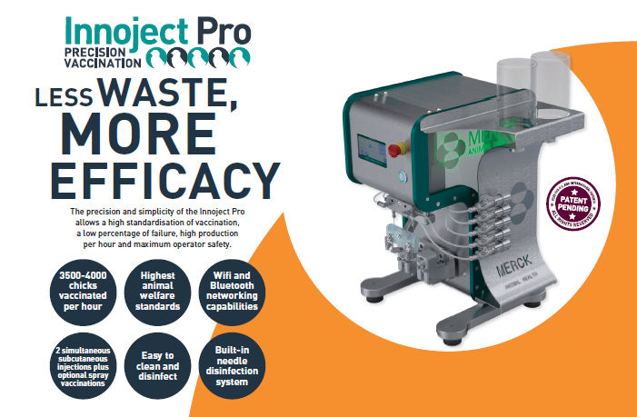
INNOJECT PRO
BY AUTOMAZIONI VX SRL
Vendor Number 3300127 / Net 30
Purpose:
  Subcutaneous & eye spray vaccination device used in hatcheries for day old poultry vaccination. Innoject Pro Single offers 1 subcutaneous injection and Innoject Pro Double offers 2 simultaneous subcutaneous injections. Both offer an optional spray vaccination.
Used With Vaccines Such As:
  Water-Base or Oil-Base vaccines. Spray Coccidiosis vaccines applied in hatcheries. Not specific for one product range.
 | Description
 | Innoject Pro Single
 | Innoject Pro Double
 | Innoject Pro Single + Spray
 | Innoject Pro Double + Spray

Slide 7
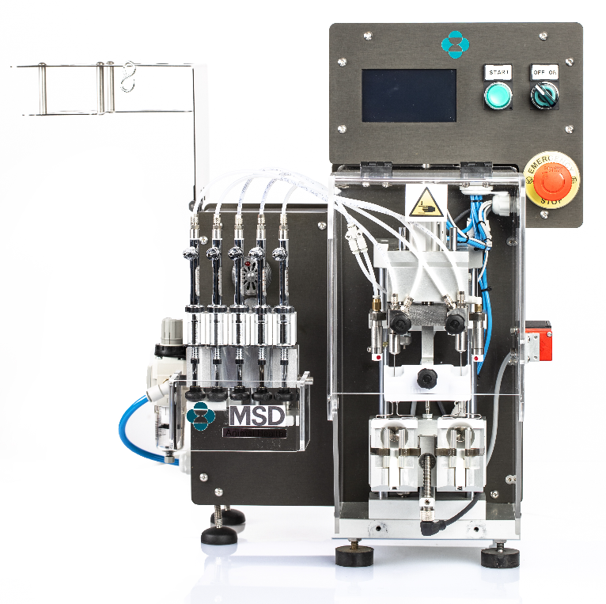
JECTMATIC V2
BY AUTOMAZIONI VX srl
Vendor Number 3300127 / Net 30
Purpose:
    Subcutaneous vaccination device used in hatcheries. Through vertical movements raising the chicks upwards carefully, and in an ergonomic way, on to the vaccination site and vaccinating the day-old chicks, and up to 12-day LAYERS. Jectmatic V2 Single offers 1 subcutaneous injection and Jectmatic V2 Double offers 2 simultaneous subcutaneous injections.
Used With Vaccines Such As:
    Water-Base or Oil-Base vaccines. Spray Coccidiosis vaccines applied in hatcheries. Not specific for one product range.

Slide 8
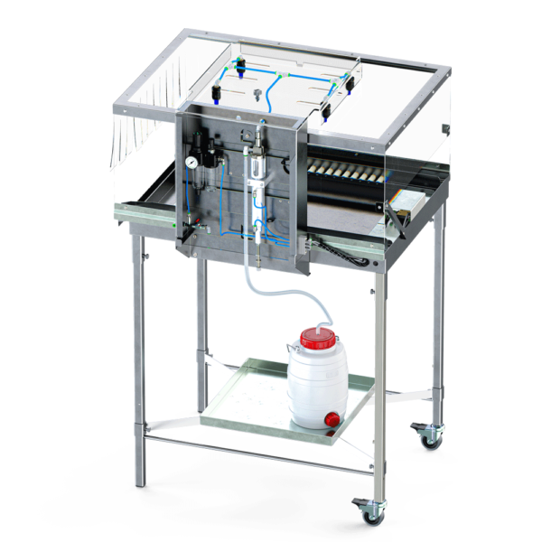
MSD MONO VACCINE HATCHERY SPRAY CABINET
BY GIORDANO POULTRY PLAST (VALERY TECHNOLOGIES)
Vendor Number 3300072 / NET 120
Purpose:
Automatic Sprayer for Poultry. Vaccinates 100 chicks with
21mL of vaccine. The vaccine is sprayed onto the chicks
and they preen themselves in order to ingest.
Used With Vaccines Such As:
Coccidiosis or Respiratory Vaccines. Not specific for just
one product range. Can apply Nobilis M65.
Information:
The device ensures the ideal distribution of the vaccine over the entire
surface of the box through four nozzles.
Suitable for the administration of different types of vaccines,
with droplet sizes from 120µm to 300µm.
Standard equipment of the different types of nozzles adapted
to the type of administration.
This device guarantees a totally independent volume,
pressure and droplet size on each dispenser.
The movement of the device is solely pneumatic. Therefore, to operate,
it only needs to be connected to a compressed area generator.
It does not require an electric power supply.
The layout of the appliance allows easy and thorough cleaning at the end of each cycle of use.
Price: € 1,381

Slide 9
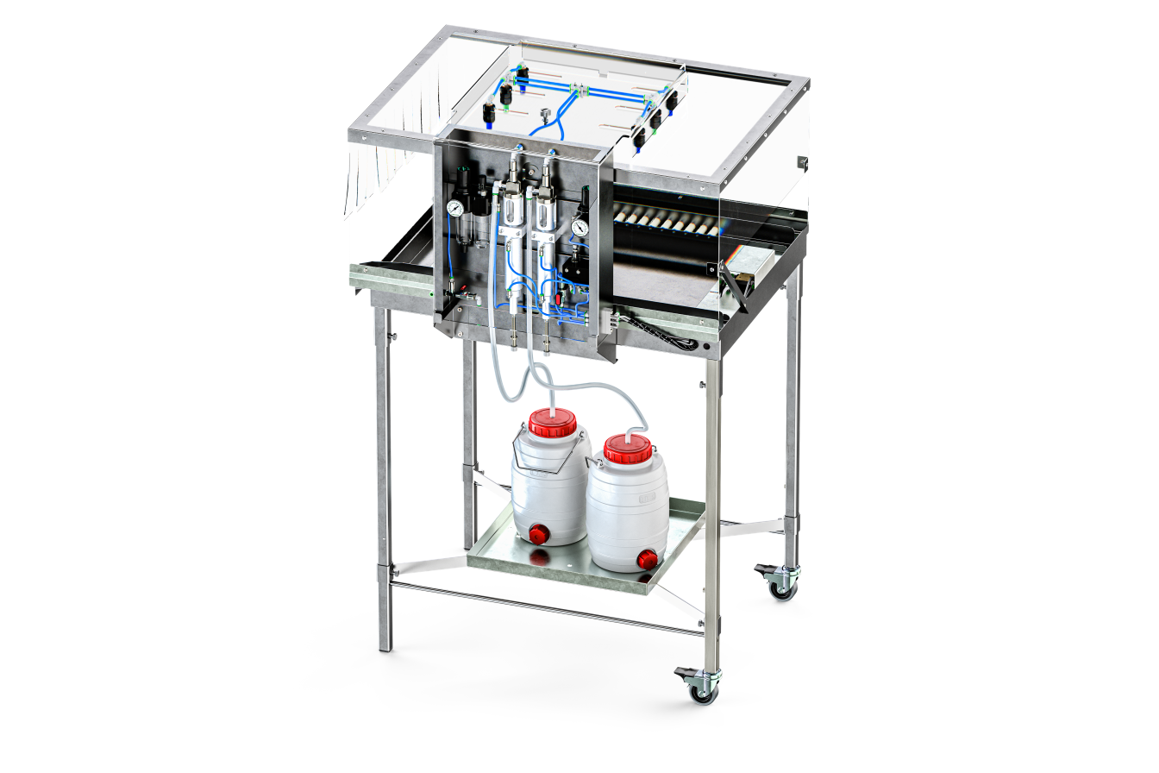
MSD DOUBLE VACCINE HATCHERY SPRAY CABINET
BY GIORDANO POULTRY PLAST (VALERY TECHNOLOGIES)
Vendor Number 3300072 / NET 120
Purpose:
    Automatic Sprayer for Poultry. Vaccinates 100 chicks with 21mL of vaccine. The vaccine is sprayed onto the chicks and they preen themselves in order to ingest.
Used With Vaccines Such As:
    Coccidiosis or Respiratory Vaccines. Not specific for just one product range. Can apply Nobilis M65.
Information:
This version combines on the same device two separate distribution systems,
such as to enable a dual vaccine intervention with a single transit of the box.
Two independent pistons allow the distribution of the vaccine over the entire
surface of the box through six nozzles.
Suitable for the administration of different types of vaccines,
with droplet sizes from 120µm to 300µm.
Standard equipment of the different types of nozzles adapted
to the type of administration.
This device guarantees a totally independent volume,
pressure and droplet size on each dispenser.
The movement of the device is solely pneumatic. Therefore, to operate,
it only needs to be connected to a compressed area generator.
It does not require an electric power supply.
The layout of the appliance allows easy and thorough cleaning at the end of each cycle of use.
Price: € 1,695
(Shaker/mixer also available if needed for an additional € 530)

Slide 10
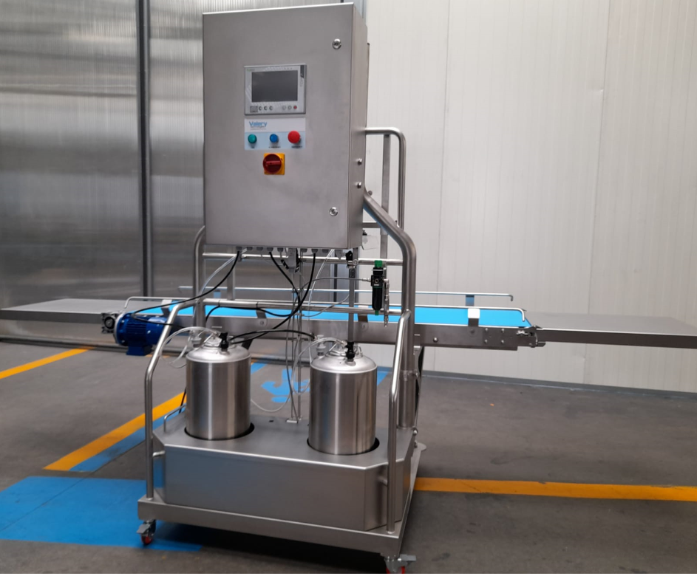
MSD MIDHAS
BY GIORDANO POULTRY PLAST (VALERY TECHNOLOGIES)
Vendor Number 3300072 / NET 120
Purpose:
    This innovative, constant pressure system uses conveyor belt technology to vaccinate chicks. The unique, constant pressure spraying technology ensures that any live vaccine is not damaged in the administration process. Two spray bar model, or gel and spray model provide simultaneous vaccination for coccidiosis and respiratory disease.
Used With Vaccines Such As:
    Coccidiosis or Respiratory Vaccines. Not specific for just one product range. Can apply Paracox, Nobilis M65, Newcastle and Bronchitis
Information:
Automatic in-line device for spray vaccination in medium and large sized hatcheries.
It is characterized by the presence of a PLC-based (programmable logic controller) system.
The device can be equipped with its own conveyor belt or combined with the existing belt in the hatchery.
The machine rests on a structure made entirely of steel.
A series of adjustable solenoids on a special cursor detect the speed and position of the box in transit.
Once the necessary parameters have been set, the machine automatically adjusts all the functions capable of guaranteeing perfect distribution on the individual boxes.
The layout of the appliance allows easy and thorough cleaning at the end of each cycle of use.
Description
MSD MIDHAS DOUBLE SPRAYER WITH CONVEYOR
MSD MIDHAS DOUBLE SPRAYER NO CONVEYOR
MSD MIDHAS GEL/SPRAY WITH CONVEYOR
MSD MIDHAS GEL/SPRAY NO CONVEYOR

Slide 11
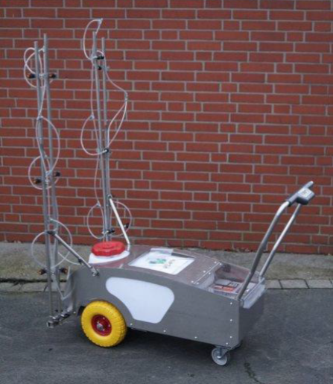
MSD SPRAY WAGON TROLLEY
BY GIORDANO POULTRY PLAST (VALERY TECHNOLOGIES)
Vendor Number 3300072 / NET 120
Purpose:
    Sprayer for application by spray-on of vaccines against various diseases in laying hens. Applies vaccination up to 6 heights at a time and can vaccinate up to 25,000 hens in half an hour.
Used With Vaccines Such As:
    Coccidiosis or Respiratory Vaccines. Not specific for just one product range
Information:
Mobile trolley supplied with a 50-liter tank.
Compact and easy to handle, with wheels suitable for using even in difficult environments.
All controls have been remoted for easy access directly from the trolley handle.
The power supply is ensured by a gel battery that allows adequate autonomy.
The operating pressure is adjustable by means of a dedicated control.
Two side rails, reclining to move them and adjustable according to the width of the corridors, are equipped with nozzles, which vary according to the type of vaccine, and are adaptable on the vertical axis to the level of the cages.
The high efficiency of the pump can guarantee constant flow and pressure.
The particular shape of the tank and the distribution system minimizes the residual quantity of product at the end of the operation.
Each dispenser is equipped with a drip stop in order to avoid incorrect distributions and waste.

Slide 12
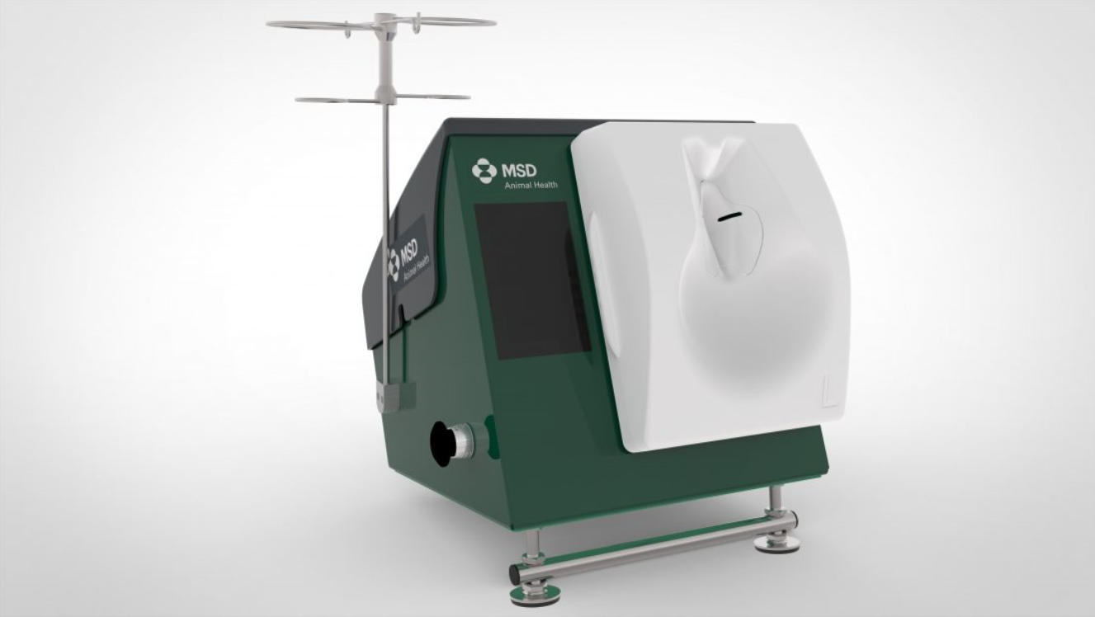
MSD DOUBLE BREAST VACCINATOR (DBV)
BY HENKE-SASS WOLF
Vendor Number 3093190 / NET 90
Purpose:
    Intra-Muscular breast injection on pullets in farms.
Used With Vaccines Such As:
    Inactivated (oily) vaccines. Not specific for just one product range.
Information:
    Double Breast Vaccinator,
    Breast Plate Layer Type
    Electricity plugs for different countries
    Breast Plate Layer Type
    Vaccine vial holder (incl. extension)
    Reusable needles 1.2 x 25
    Dripping chambers
    Syringe spare part set
    Syringes volume 0.5ml
    Measurement tool
    Allen key size 5
    Dosage measurement cup
    Fixation clamp / screw clamp
    Lubrication oil

Slide 13
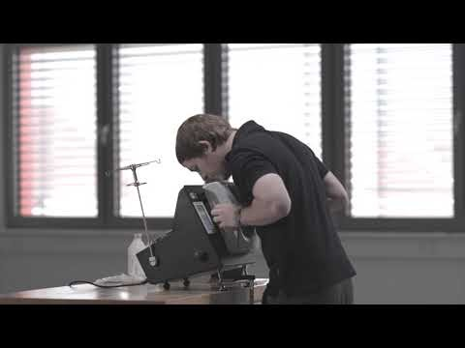
MSD DOUBLE BREAST VACCINATOR (DBV) INFORMATION VIDEO

Slide 14
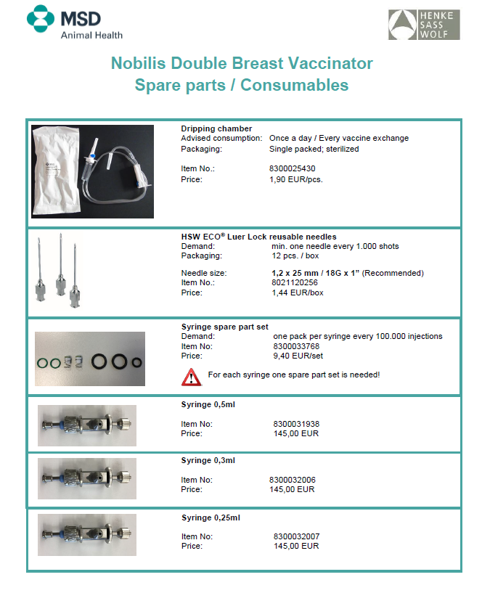
MSD DOUBLE BREAST VACCINATOR (DBV)
ACCESSORIES & SPARE PARTS

Slide 15
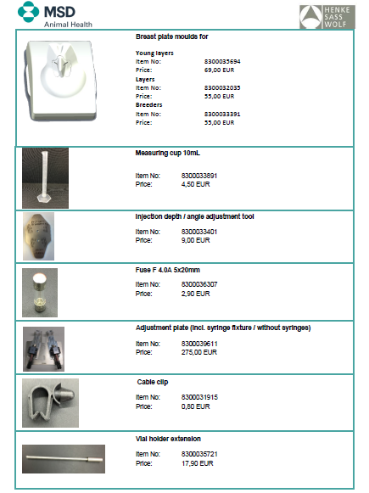
MSD DOUBLE BREAST VACCINATOR (DBV)
ACCESSORIES & SPARE PARTS CONT.

Slide 16
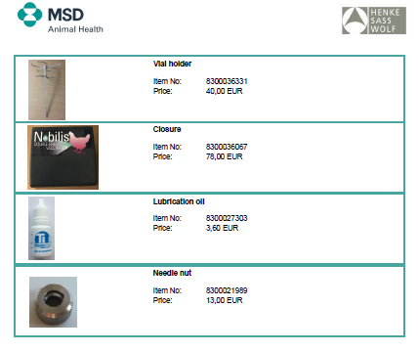
MSD DOUBLE BREAST VACCINATOR (DBV)
ACCESSORIES & SPARE PARTS Cont.

Slide 17
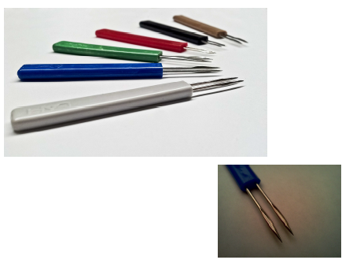
STABBER-WINGWEB
BY HENKE-SASS WOLF
Vendor Number 3093190 / NET 90
Purpose:
    Manual vaccination device that produces a double prong puncture.
Used With Vaccines Such As:
    Not specific for just one product range.
Information:
    Ideal for pox and other micro-dosage injections
    Individual & rapid handling

Slide 18
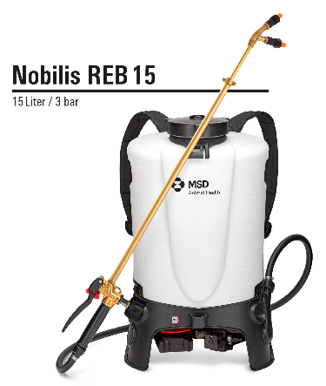
NOBILIS BATTERY POWERED SPRAYER REB 15
BY BIRCHMEIER
Versions: EU, UK, AUS, US (Merck)
Vendor Number 3085960 / Net 90
Purpose:
Battery powered backpack sprayer for Poultry vaccination. Vaccine is sprayed directly on poultry for efficient mass vaccination.
Used with vaccines such as:
Coccidiosis or Respiratory Vaccines. Not specific for just one product range. Can apply Paracox, Coccivac, Nobilis Ma65, etc.
Device specification:
  Transparent 15-liter tank with imprinted filling graduation in liters and US gallons
  Ergonomic design with recessed grips and comfortable shoulder straps with click-system
  Special white plastic tank with black MSD label
  Electronical pressure control, adjustable from 1 to 3 bar (constant pressure)
  Including long lasting 2 Ah CAS battery with quick-change system
  Equipped with 2 x special fan-jet nozzle TX-VS2 (white) for fine spray
  Plus additionally 2 x fanjet nozzle TXVK 18 (orange) for course spray and 2 x Intervet spray nozzle
  0.5 to 1.0 m telescopic lance with double nozzle carrier
  Robust pump, large filling opening with strainer and tank-outlet through suction system
  Control through electronic: constant pressure, on/off and pump-protection features as well as charge of battery display
  Including charger for CAS Li-Ion batteries (EU, UK, AUS and US version), charging time < 1h
  Robust brass trigger valve with integrated fine filter and with locking and blocking function
  Due to electronical control, no electric pilot wire connection to the trigger valve needed, thereby problem-free use and access to a wide range of standard accessories from Birchmeier.
Art.No. 12112001

Slide 19
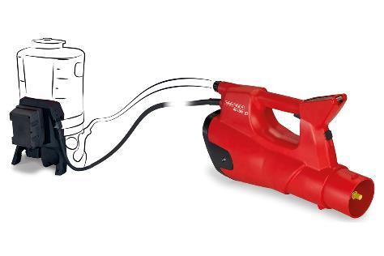
AS 1200 SPRAYER BLOWER WITH BATTERY*
BY BIRCHMEIER
Versions: EU, UK, AUS, US(Merck)
Vendor Number 3085960 / Net 90
Purpose:
    For effective vaccination of hens and pullets in aviaries. This device carries out nebulization with a powerful jet that allows for efficient vaccination without having to get as close to the pullets and hens (Please refer also to the paper from MSD France ‘Effective vaccination of hens by pullets in aviaries with AS 1200’ (NR-FG-FR-NOB-191000003).
Used with vaccines such as:
    Respiratory Vaccines
Information:
    Portable, battery driven spray blower AS 1200 for use in combination with the battery driven backpack
    sprayer Nobilis REB 15 (or previous model Nobilis REC 15) from Birchmeier
Supplied with its own battery, charger and battery-rack for mounting on Nobilis REB 15
Spray autonomy of 1.5 to 2 hours with speed step 3 (out of 5)
Supplied with special hollow cone nozzle TXVK-6 for fine mist (evaluated by MSD/Merck France)
Adjustable droplet size and flow rate (by pre-pressure setting on Nobilis REB 15 and nozzle type selection)
Adjustable reach (up to 7m with TXVK-6 nozzle) by varying air flow (5 steps plus booster step)
Due to controlled parameters a very homogenous spray pattern is achieved
Droplet range up to 7 meters
      0.2 l / 1’000 hens with TXVK-6 nozzle (Art. No. 50142057 (red)).
      0.1 l / 1’000 hens with stainless steel nozzle TXSS2 (Art. No. 119 576 01) from Nobilis REC 15 or nozzle TX-VS2 (Art. No. 12116601 (white)) from Nobilis REB 15.
      More vaccine solution is better (ex: 0.3 to 0.4 l/1000 hens is better with red nozzle)
Nobilis REB 15
Art.No. 12112001
AS 1200 *)
Art.No. 12052101
  * AS 1200 must be used with Nobilis REB 15 or REC 15 in order to operate.

Slide 20
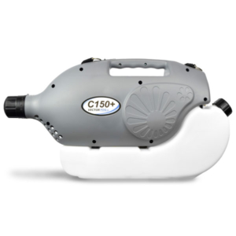
VectorFog C150 PLUS
BY vectornate
Vendor Number 3085960 / Net 90
Purpose:
    Fogger for use with respiratory vaccinations.
Used with vaccines such as:
    Respiratory Vaccines. Not specific for just one product range.
Information:
    Corded Cold Fogger C150+ (must be plugged into power source)
  Tank Capacity 6 Liters
  Power 220V / 110V
  Flow Rate 60LPH
  Droplet Size 5 – 50 microns
  Net Weight 4.5 kg
  Dimensions 63 x 19.5 x 31 cm

Slide 21
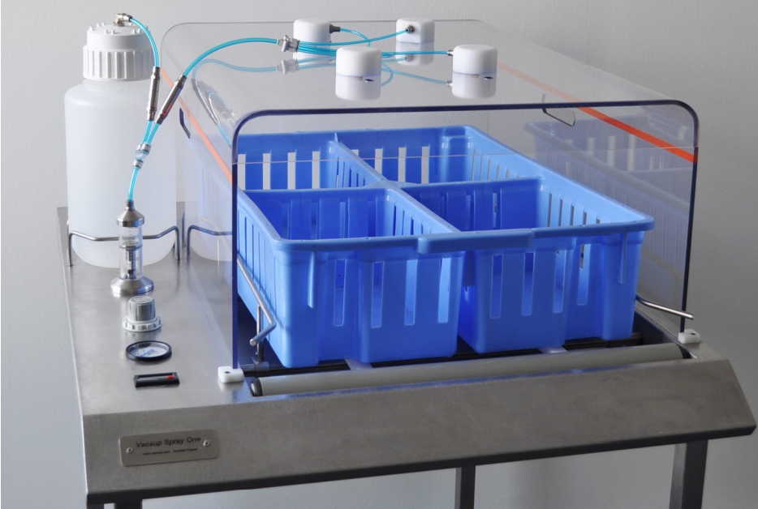
Vacsup Spray One
BY ANNODIS
Vendor Number 3130235 / Net 90
Purpose:
    an efficacious spray cabinet for administration of live vaccines to day old chicks.
Used with vaccines such as:
    Respiratory live Vaccines. Not specific for just one product range.
Information:
  Air pressure supply: 4 bars minimum
  Vaccine tank: 4 liters (5 liters option)
  Crate Size: 50 x 68 cm (maximum)
  Speed Indication: 300 - 400 crates per hour
  Spray Volume: 10 - 23 ml per crate
  Droplet size: 150 - 260 micron average

Slide 22
Supplier Contact Information:
MSD Animal Health FZ-LLC
      Office number +971-4-4468001
      gulflevant_mah@merck.com
      Alpha Building (EIB05)
      Suite 01, G Floor
      Dubai Internet City
      P.O. Box 502947
      Dubai, United Arab Emirates

